Slide 1

CMSC 434 Kiosk-0201-05 Phase 2
UMD Computer Science

Slide 2
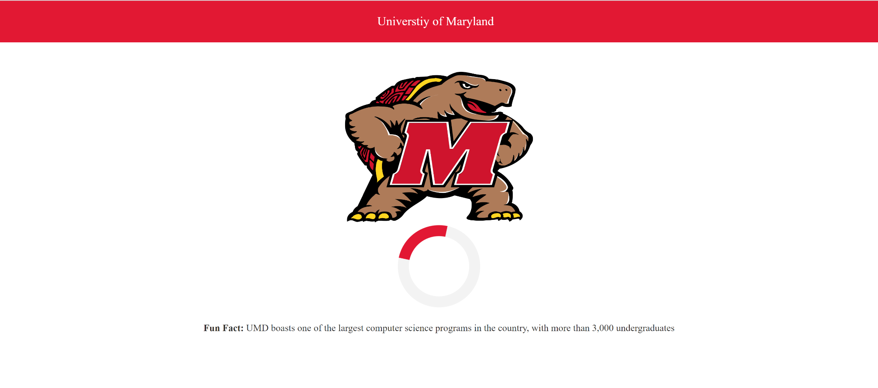
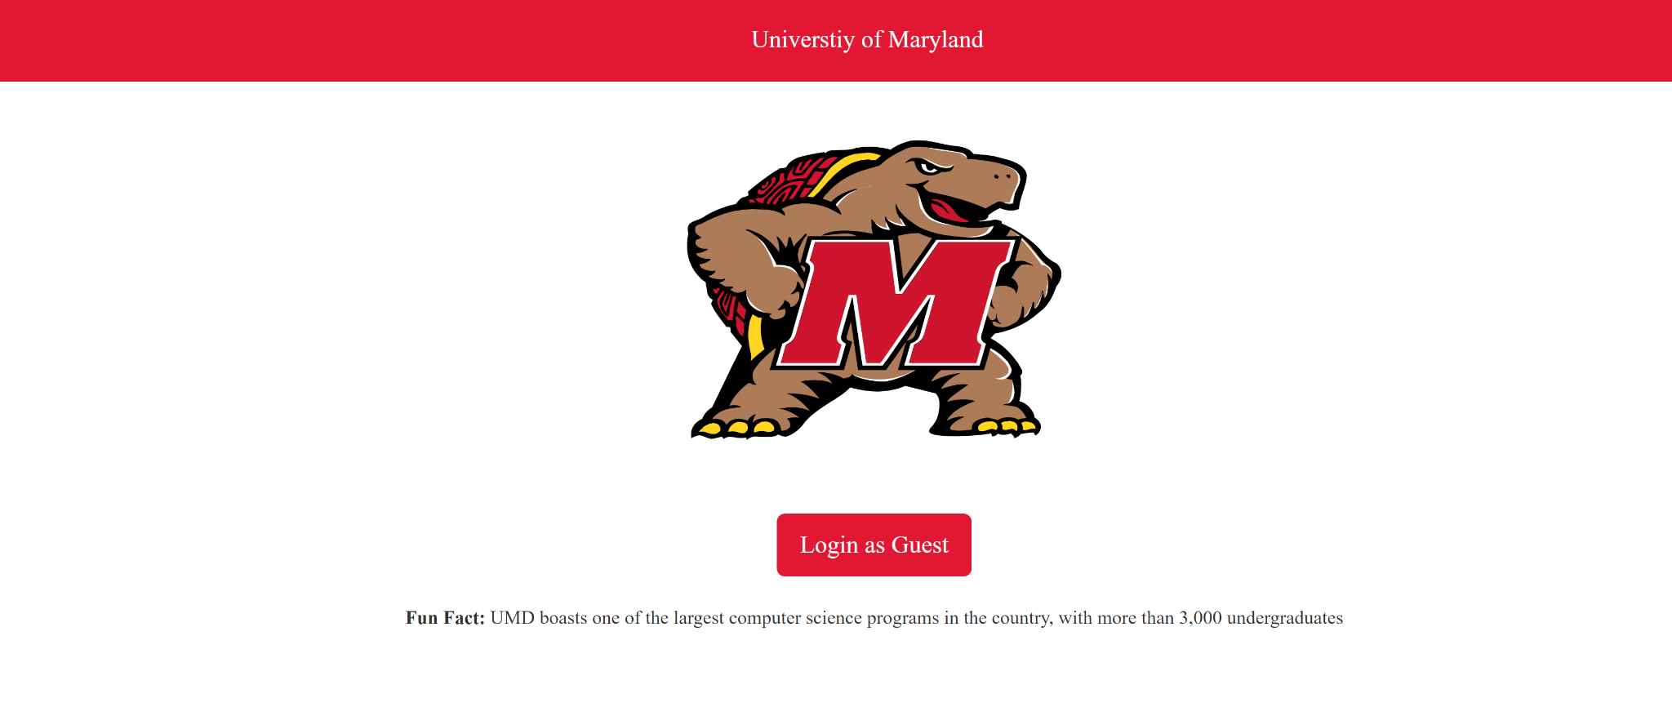
Start Screen
Notes:
The kiosk first lands on the start screen. This page shows Testudo and a fun fact to keep the user engaged and asks the user to log in. The user then logs in using the button shown in the picture. The button gives the user clear information stating “Login as guest”which is a clear indication telling the user to log in. We wanted to make this starting point welcoming and clear with few elements too avoid clutter as the user starts

Slide 3
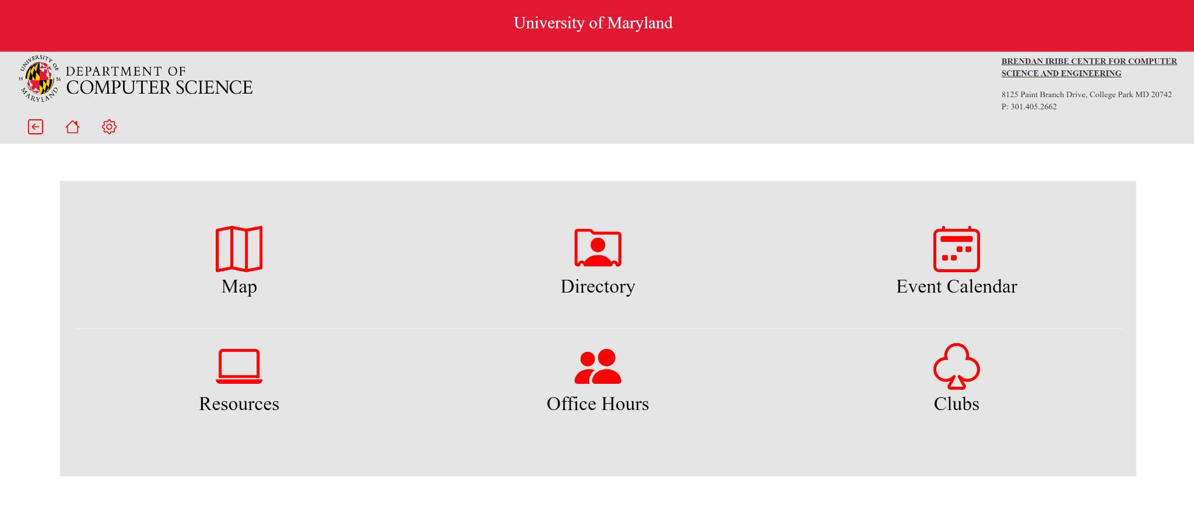
Home Screen
Notes:
This is the home screen for the Kiosk. The home screen acts as a jumpad for the 6 main functionalities of our kiosk. Once the user starts the kiosk and “logs-in” they will be taken to this page where they can see what different actions are available. We separated these 6 main functionalities based off of responses we got from other students on campus and what they thought would be helpful. Our 6 main tabs are an interactive map, a directory, an event calendar, a resources page, an office hours database, and a clubs page. The use can click on any of these icons and will be taken to the corresponding page.

Slide 4
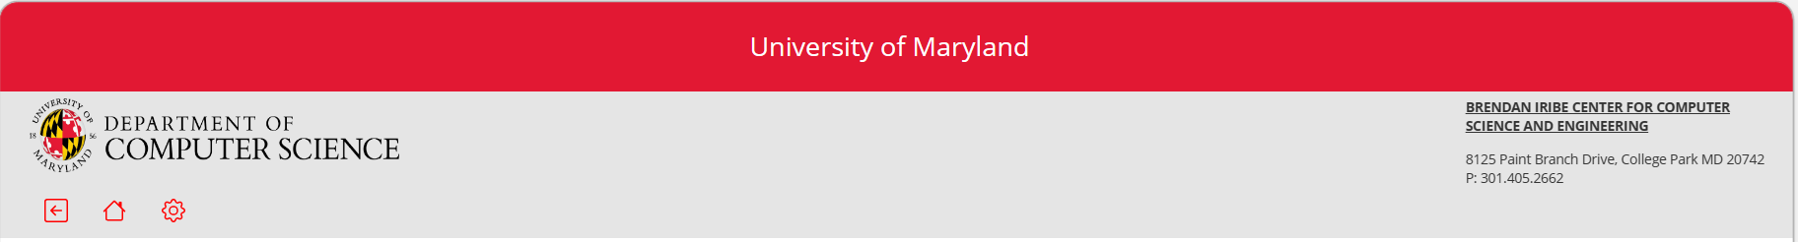
Nav Bar
Notes:
This is the nav bar for our Kisok. The nav bar contains a settings button, the home button which allows the user to return to the homepage. The navbar also contains the back button which takes the user back to the homepage. This navbar also contains the address for the computer science building as well as the name for the building. This gives the user the most basic information for the building. We wanted to have a standardized navigation bar across each screen to give the product a sense of professionalism and seem uniform with other products at the university

Slide 5
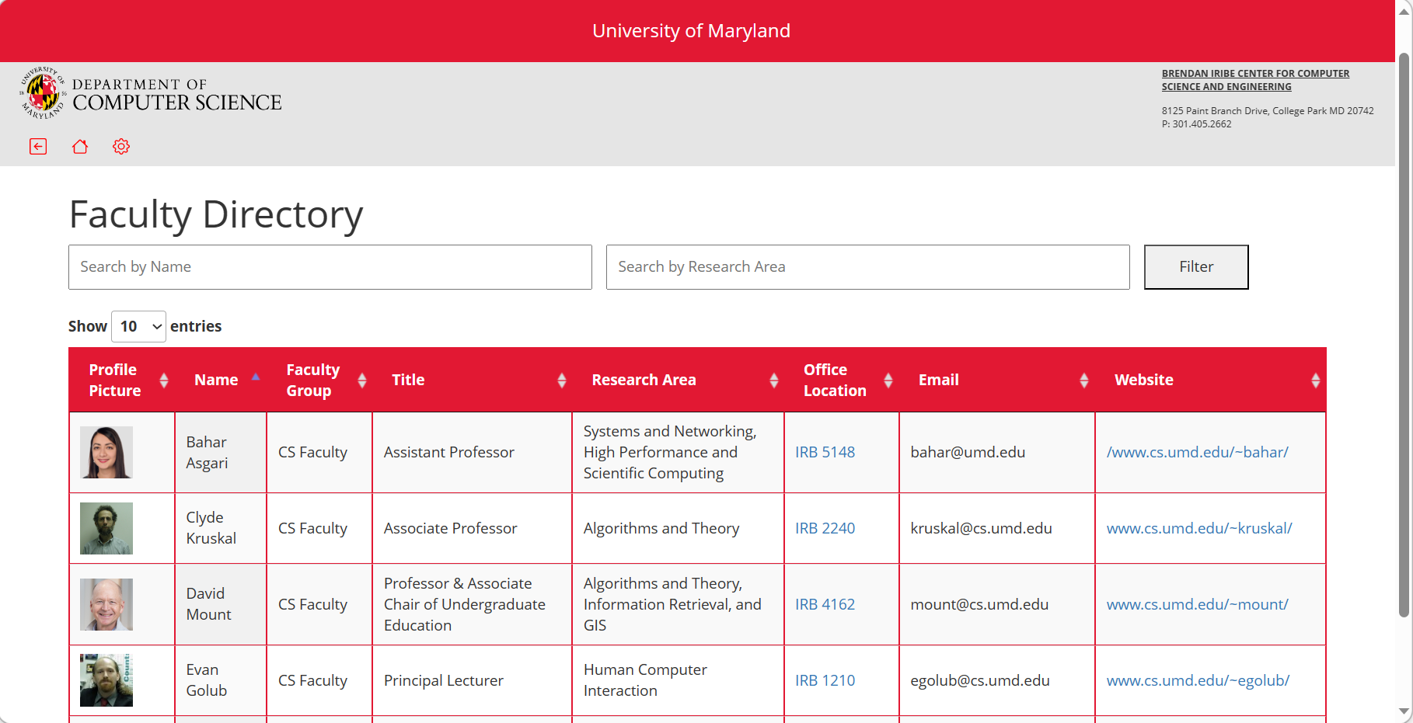
Directory Screen
Notes:
Firstly the directory page. The directory page shows different faculty within the computer science department. This page allows users to filter by the faculty name and research area. The user also has the option to sort by any of the different columns in ascending or descending order. As you can see there is a lot of information contained in this database. We have a picture of the faculty member, their name, their faculty group, their title, research area, office location, email, and website. We wanted to include all this information because we envision this page being multi purposed in the future. The first main use would be looking up a faculty member to find their office or email. But, what we thought would be really cool is being able to filter by the research area to try and explore different research programs on campus and potentially seek out mentors. Another functionality of this page is that if you were searching for a faculties room number you can actually click that room number and be taken to the interactive map section of our product

Slide 6
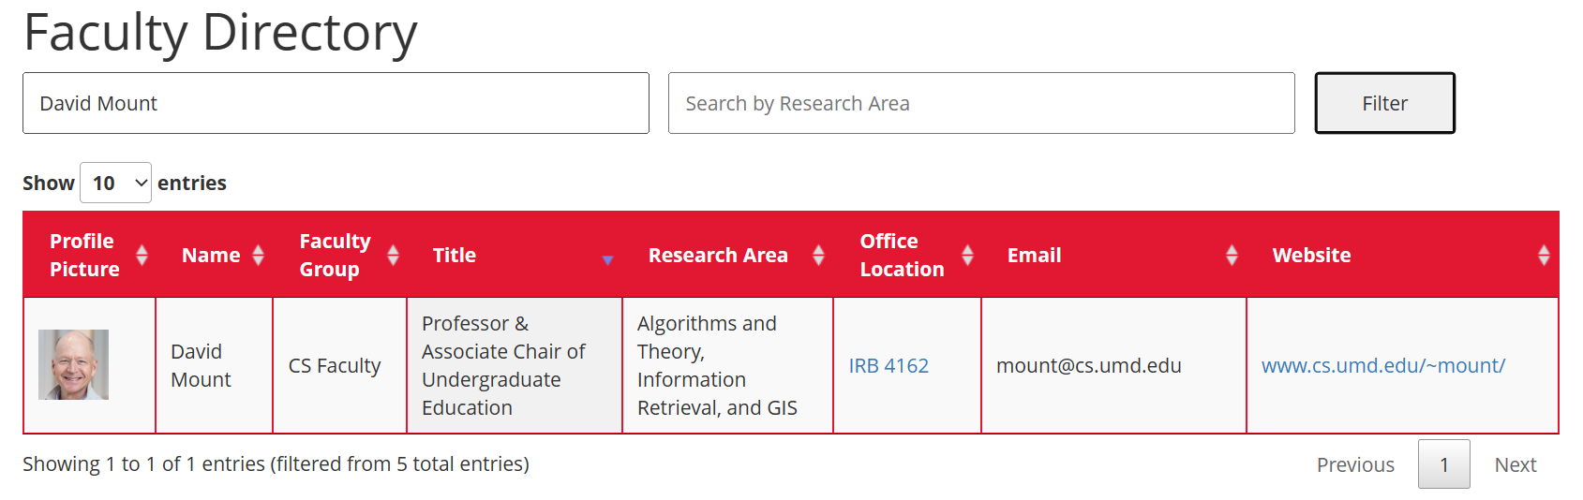
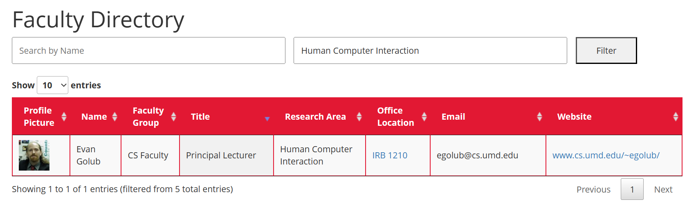
Directory Screen - Search Functionality
Search by Name
Search by Research Area
Notes:
Here we can see the different filters being applied to the database. Now lets say you wanted to find Professor Golubs office location we could simply click the link and be taken to our next section the map.

Slide 7
Home Screen
Notes:
Now that weve seen the map functionality is being used in our directory lets explore the map tab

Slide 8
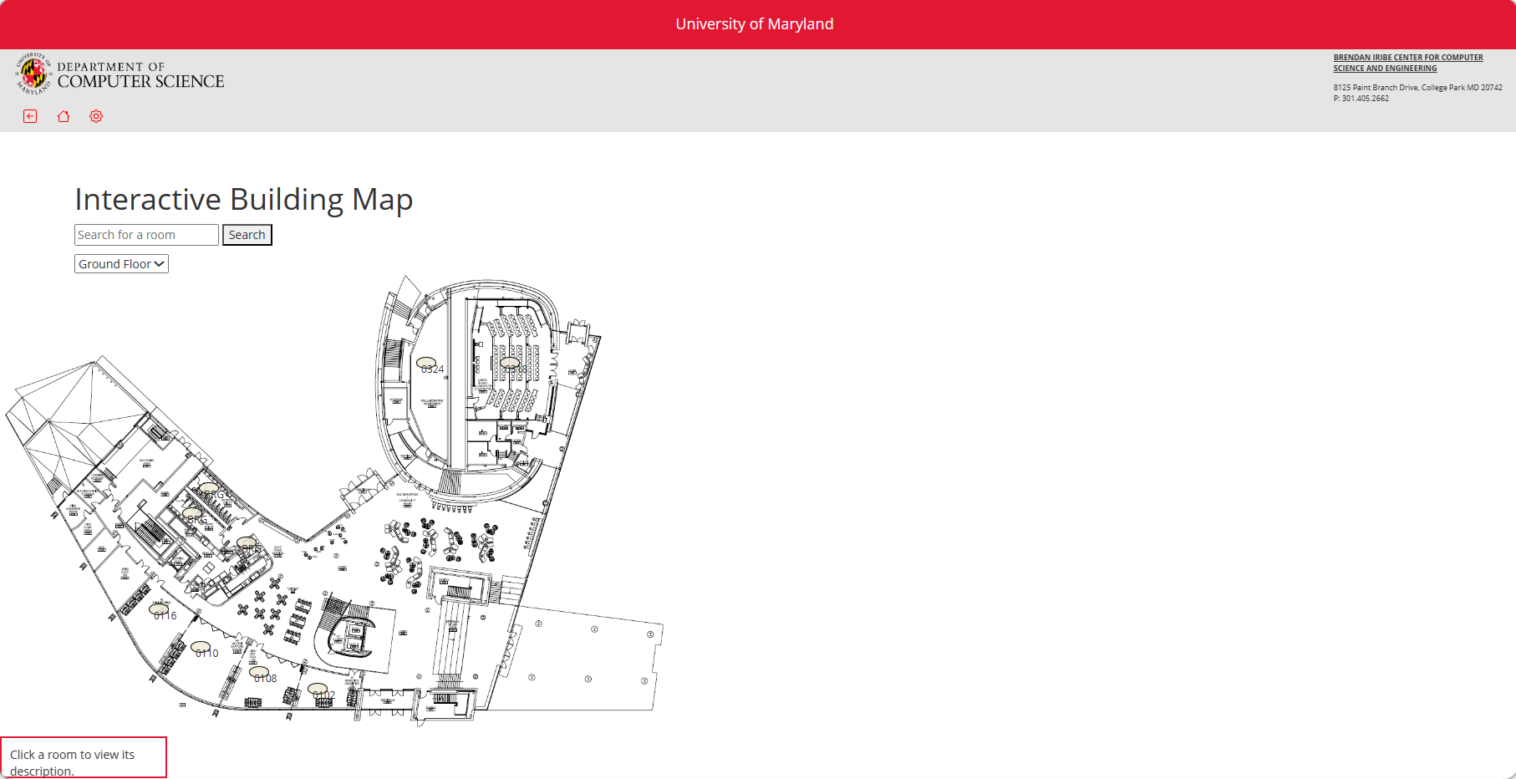
Map Screen
Notes:
The Map button takes the user to the map screen. The map screen contains an interactive building map which shows a map of the building and the different rooms on the floor. Here we can the layout of each floor and each room on those floors. Our map section has 3 other main functionalities, searching for a room, reserving a room, and seeing information on the rooms. For example one could click on an office and see a small description outlying that it is Professor Golub’s office, a study lounge, or a lecture hall.

Slide 9
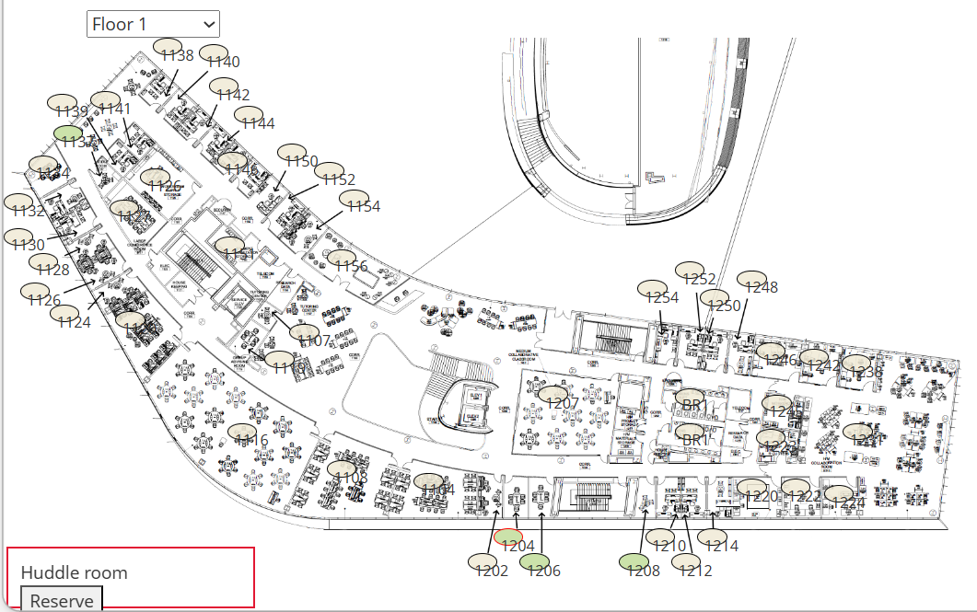
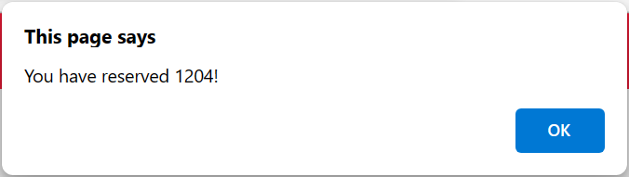
Map Screen - Reservation Functionality
Room Confirmation Notification
Reserve Available Rooms in Green
Notes:
Here we can see the reservation functionality of the map. There are many study rooms available for students that you can reserve ahead of time. If you click on one of the huddles and hit reserve you can reserve it through our kiosk

Slide 10
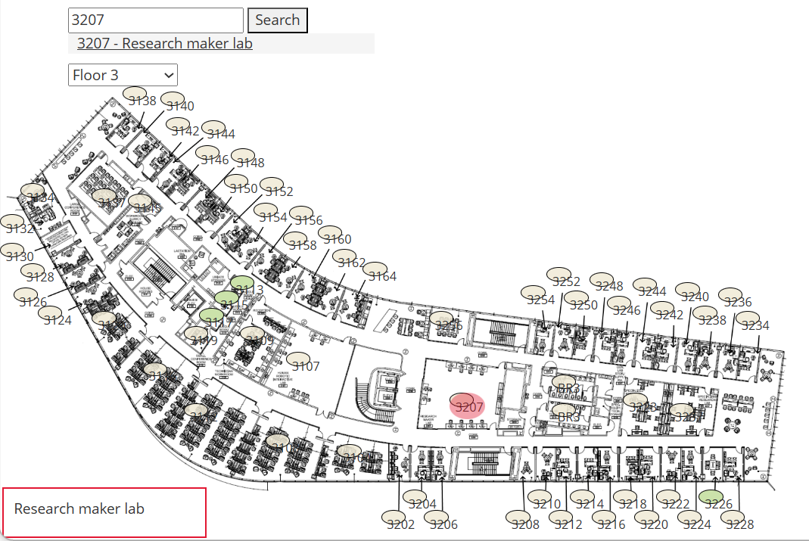
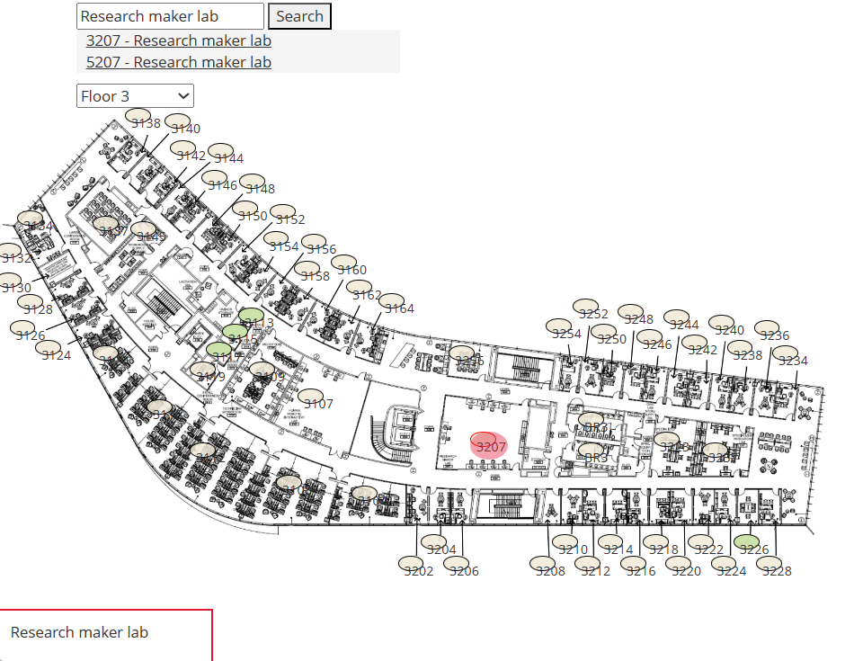
Map Screen - Search Bar Functionality
Search by Room Number
Search by Room Function
Notes:
Here you can see the search bar functionality. Any user who wishes to look up a room or office number in Iribe can simply type in the code and will be shown the floor and where on that floor the room is located

Slide 11
Home Screen
Notes:
Back to the home screen. Now we are gonna take a look at the calendar.

Slide 12
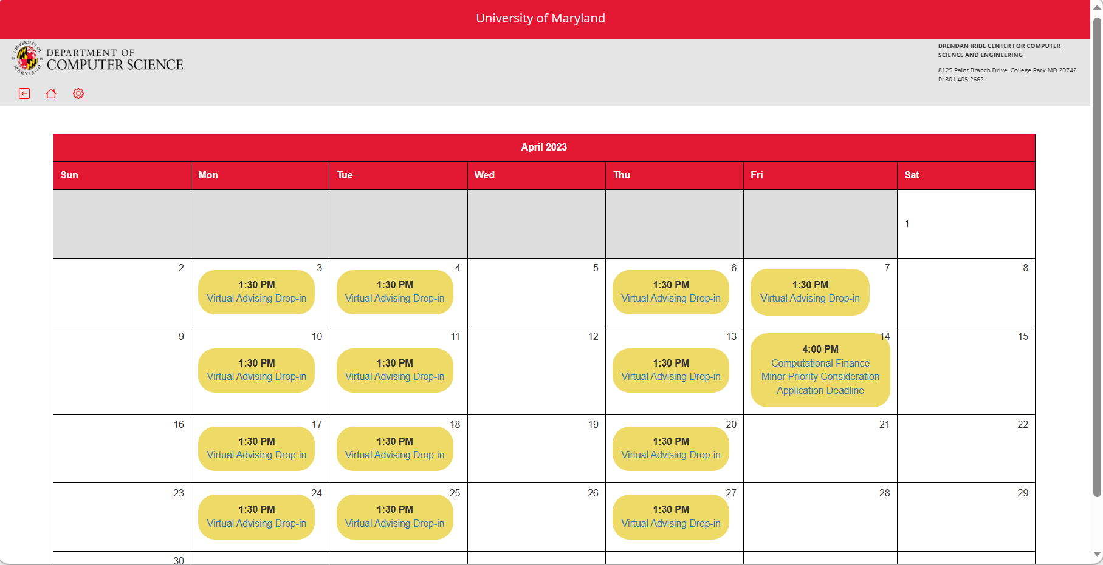
Calendar Screen
Notes:
There are many events at Iribe but often times students miss these opportunities because they didn’t know of the event. With our calendar users will be able to see all upcoming events and can follow the links to see more information or sign up for the event. We think this will promote activity on campus and give students more access to the amazing events that our hosted at iribe

Slide 13
Home Screen
Notes:
The next page we will look at is our resources page.

Slide 14
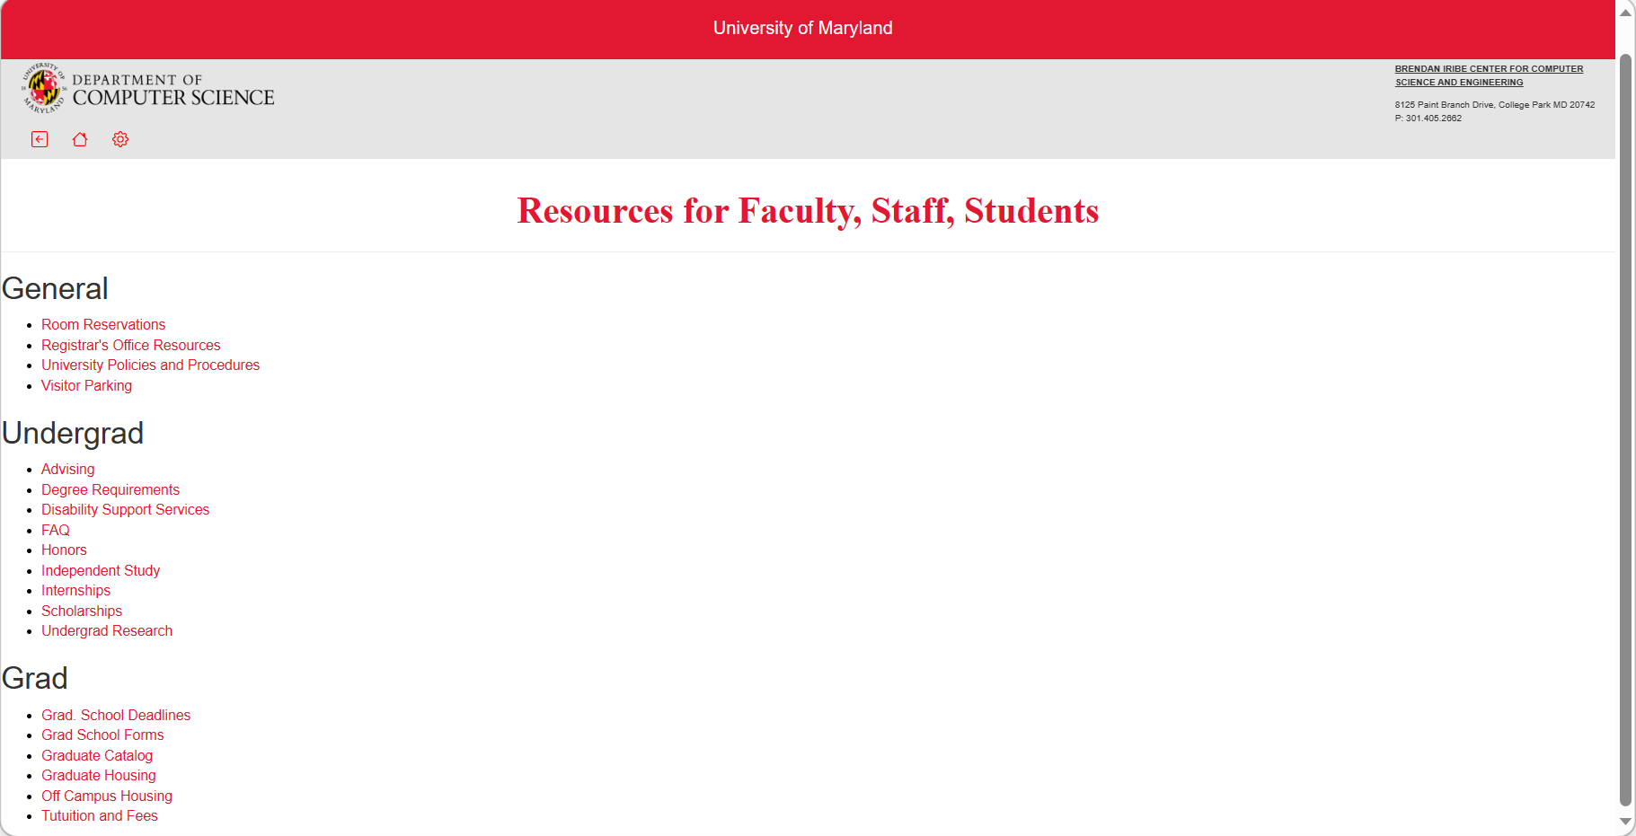
Resources Screen
Notes:
This page acts as a sort of jumpad for all the different resources available to students. There are many different resources available to students but are not well advertised and hard to locate. Often times students are unaware that they have these resources available in the first place. With the kiosk users will be able to see a clear organized list of the different resources available to them

Slide 15
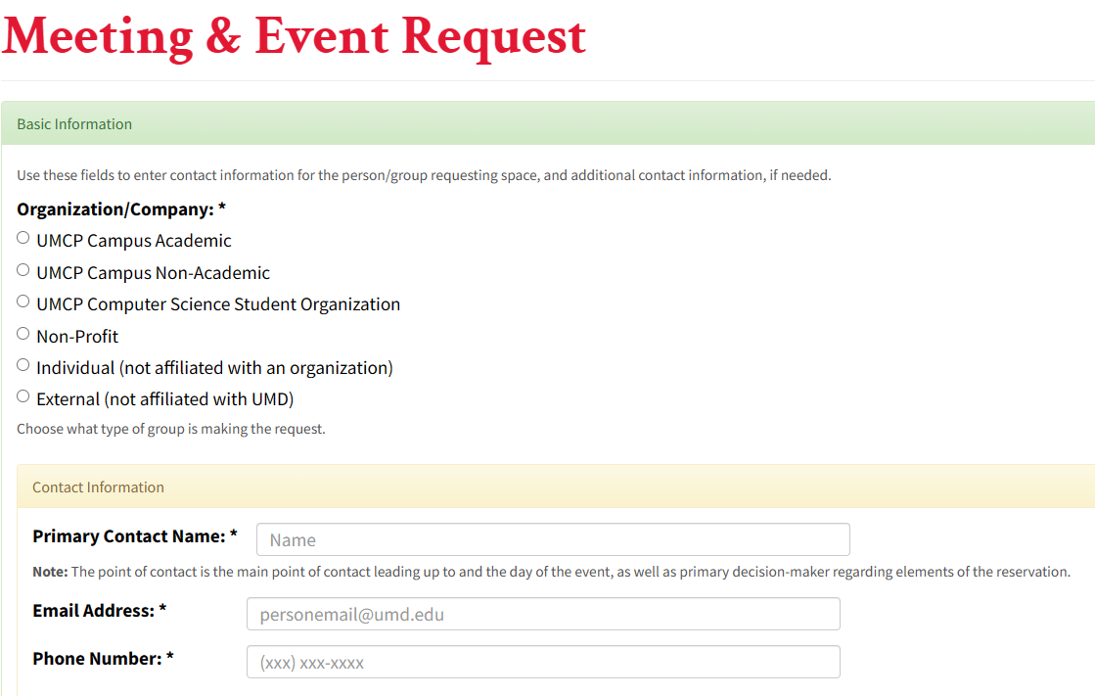
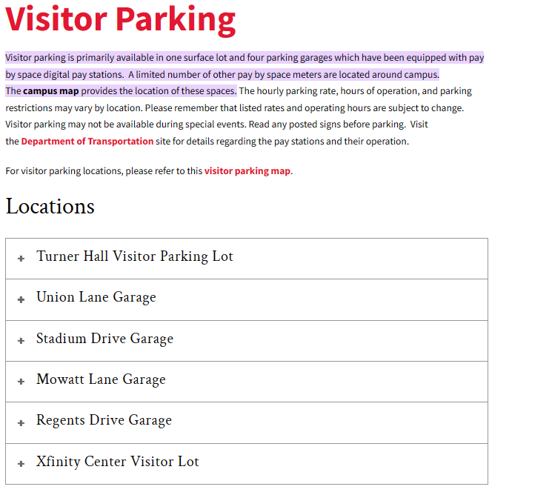
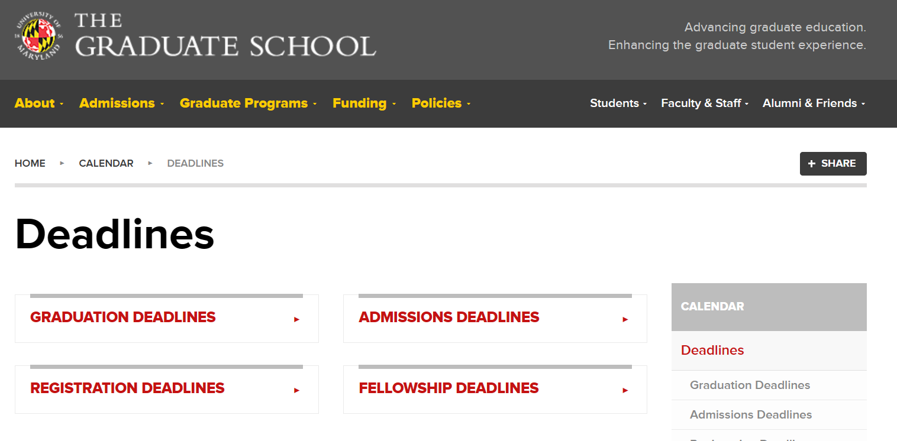
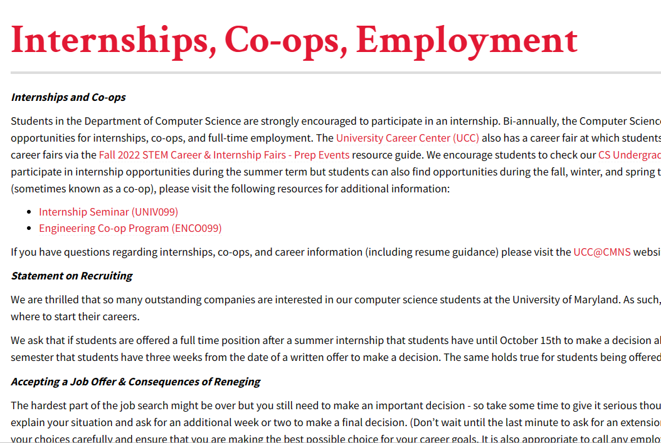
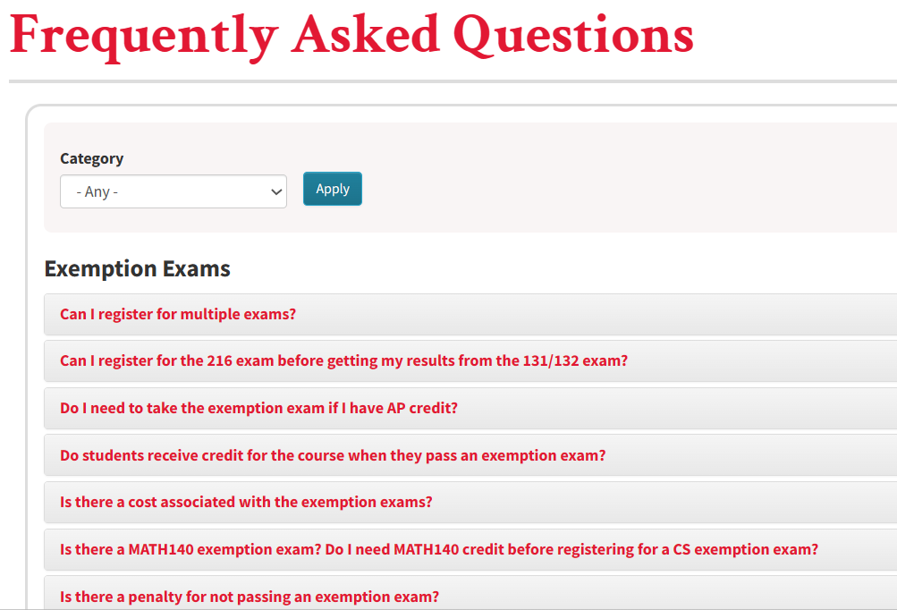
Resources Screen
Notes:
Here you can see some of the resource links available to studnets

Slide 16
Home Screen
Notes:
The next page we will look at is the office hours tab

Slide 17
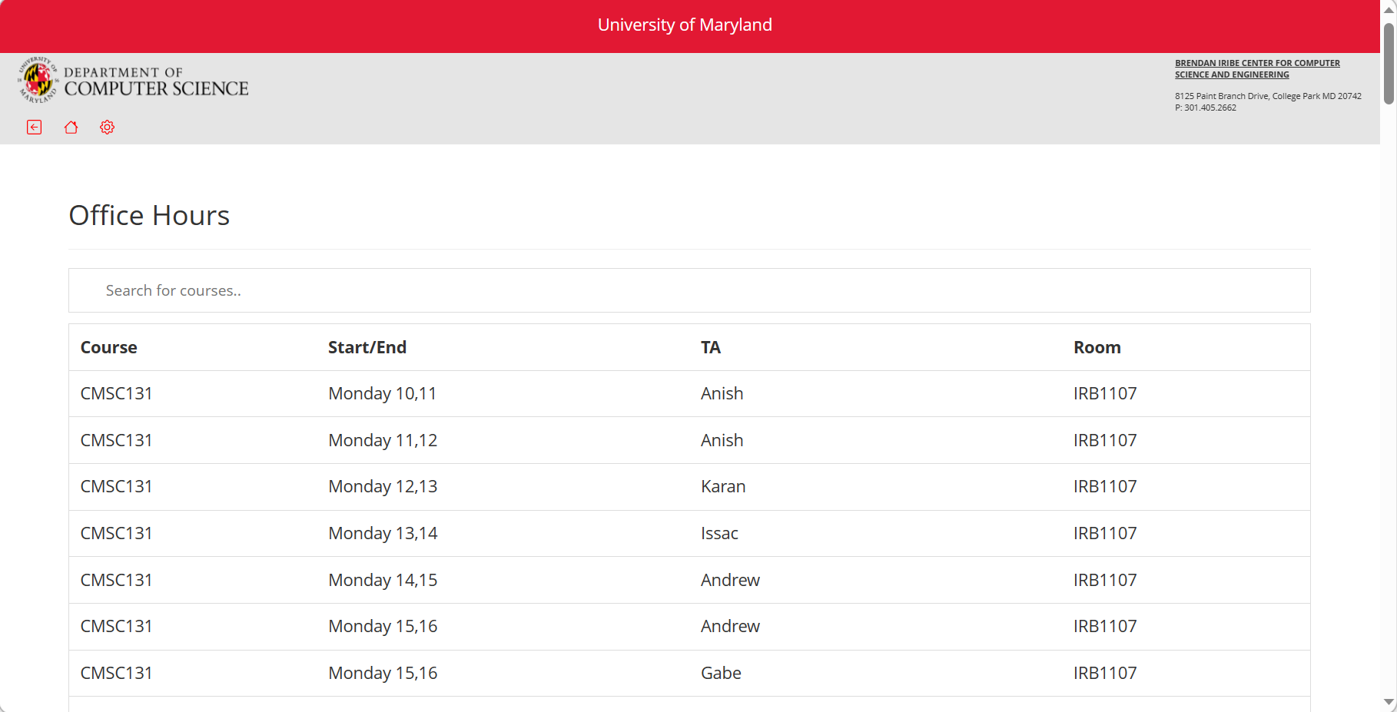
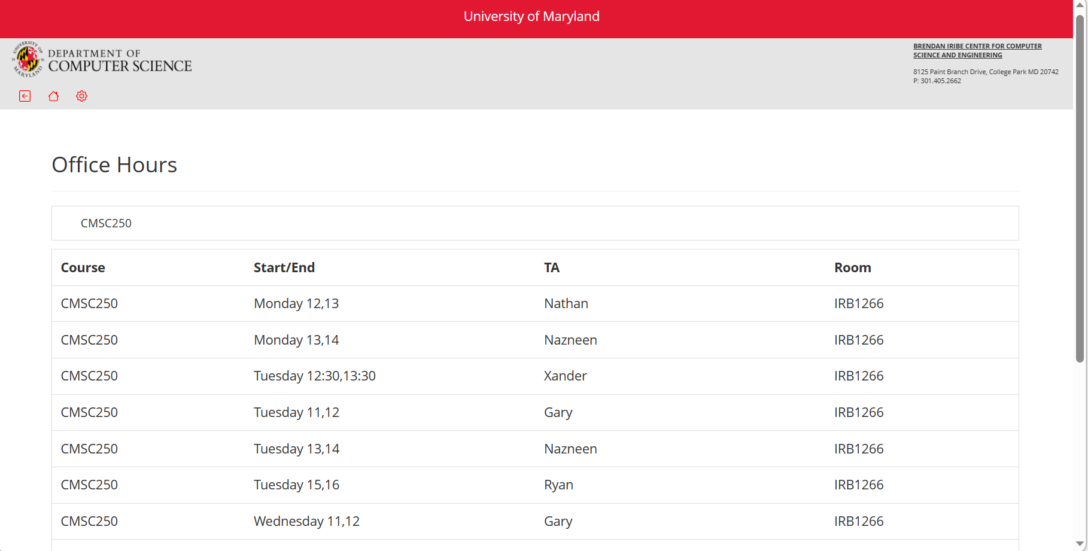
Office Hours Screen
Notes:
This tab is a large database of all the different office hours for different cmsc courses. The user can search by course to find the office hour location, time, and ta for the course they are looking for.

Slide 18
Home Screen
Notes:
Lastly, we will look at the clubs page.

Slide 19
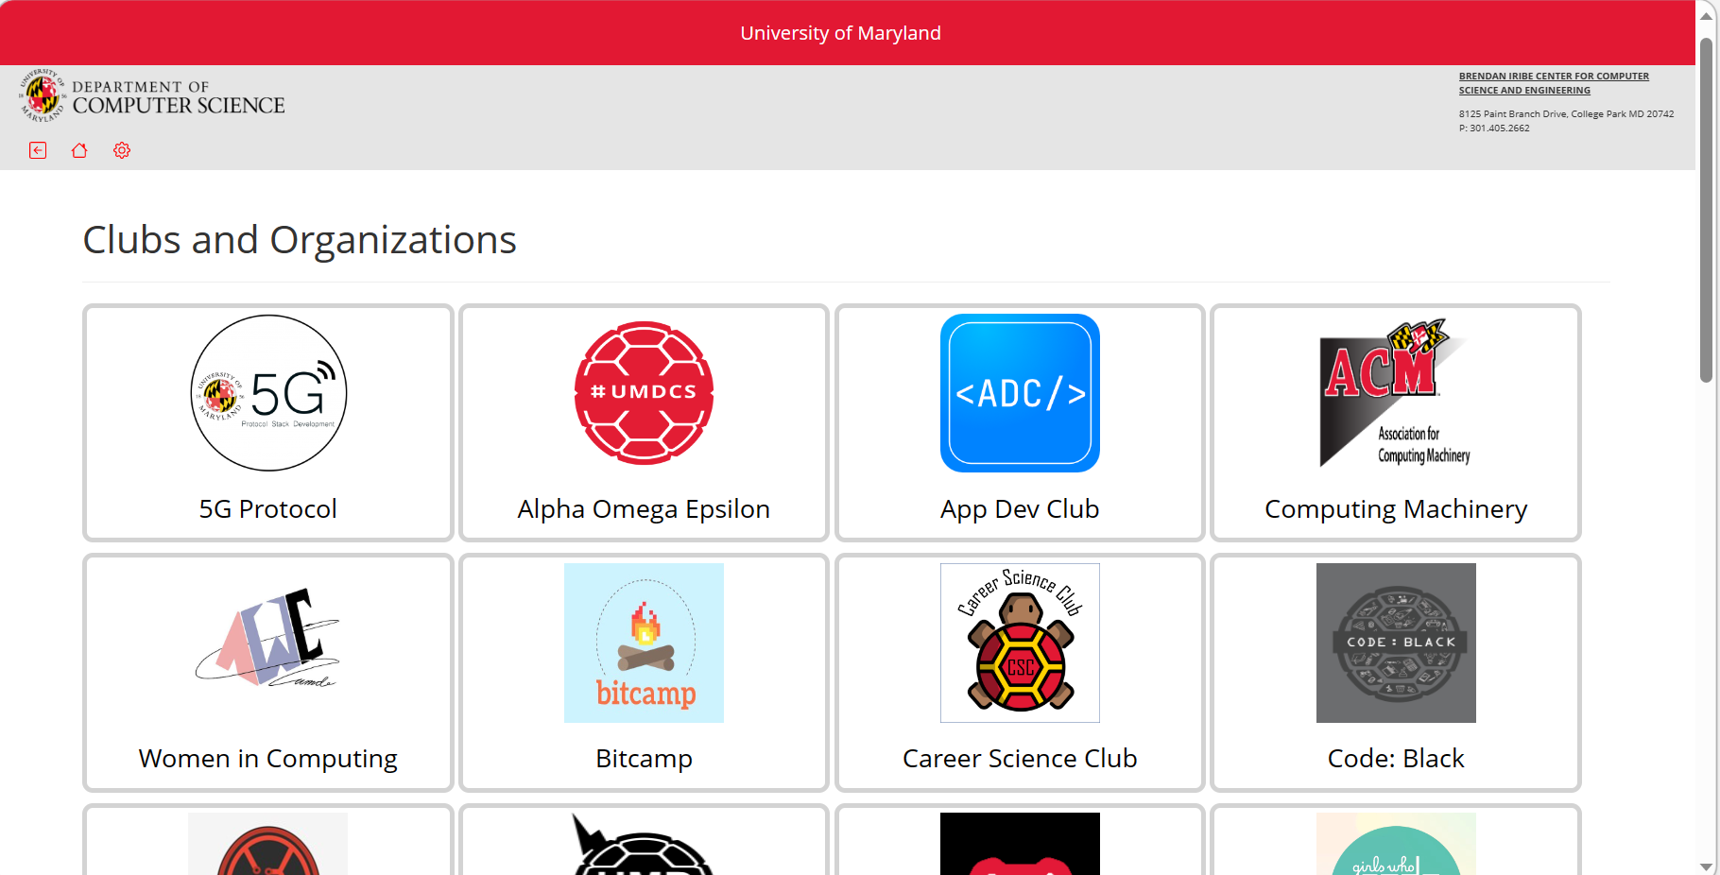
Clubs and Organizations Screen
Notes:
There are so many great clubs and organizations on campus and many dedicated to computer science specifically. We wanted to make a page to showcase all of these different clubs and promote campus activity within the computer science department by helping students connect with each other.

Slide 20
Thank you!

